Slide 1
Healthy Start
Additional resources & training
Jennifer Nicol SSBC Marketing & Communications Officer

Slide 2
Resources & promotional materials
Healthy Start resources page on the SSBC website.
www.smallstepsbigchanges.org.uk/resources/healthy-start

Slide 3
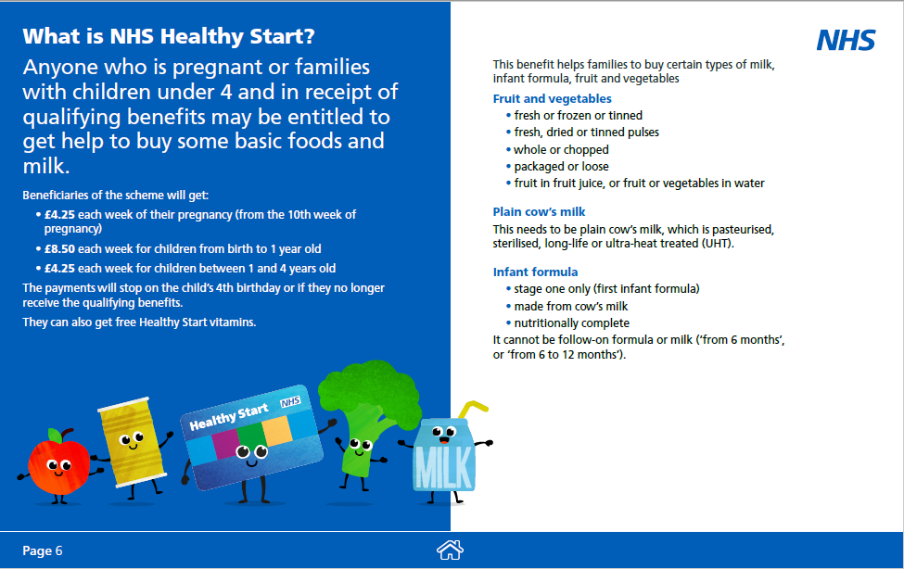
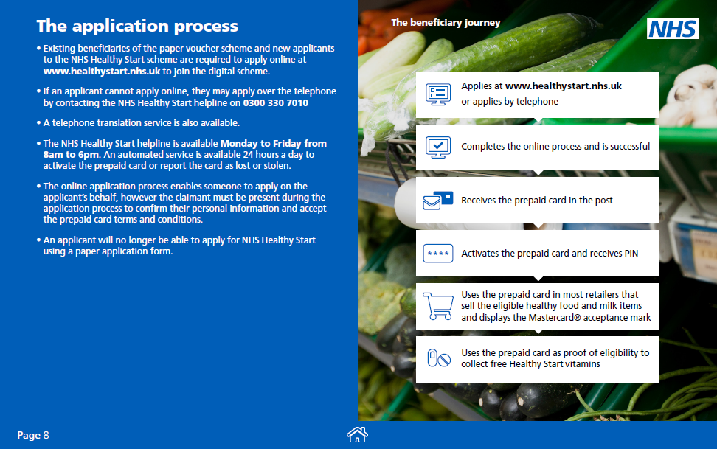
Guidance for professionals
Healthy Start guidance pack for healthcare & family support professionals.
Download from the NHS or SSBC website.
www.media.nhsbsa.nhs.uk/resources

Slide 4
Social media promotion
Healthy Start branded social media graphics available to download from the NHS website.
Two packs:
Transitioning current beneficiaries of Healthy Start to the digital scheme.
Targeting eligible families who have not yet signed up for the scheme.
www.media.nhsbsa.nhs.uk/resources

Slide 5
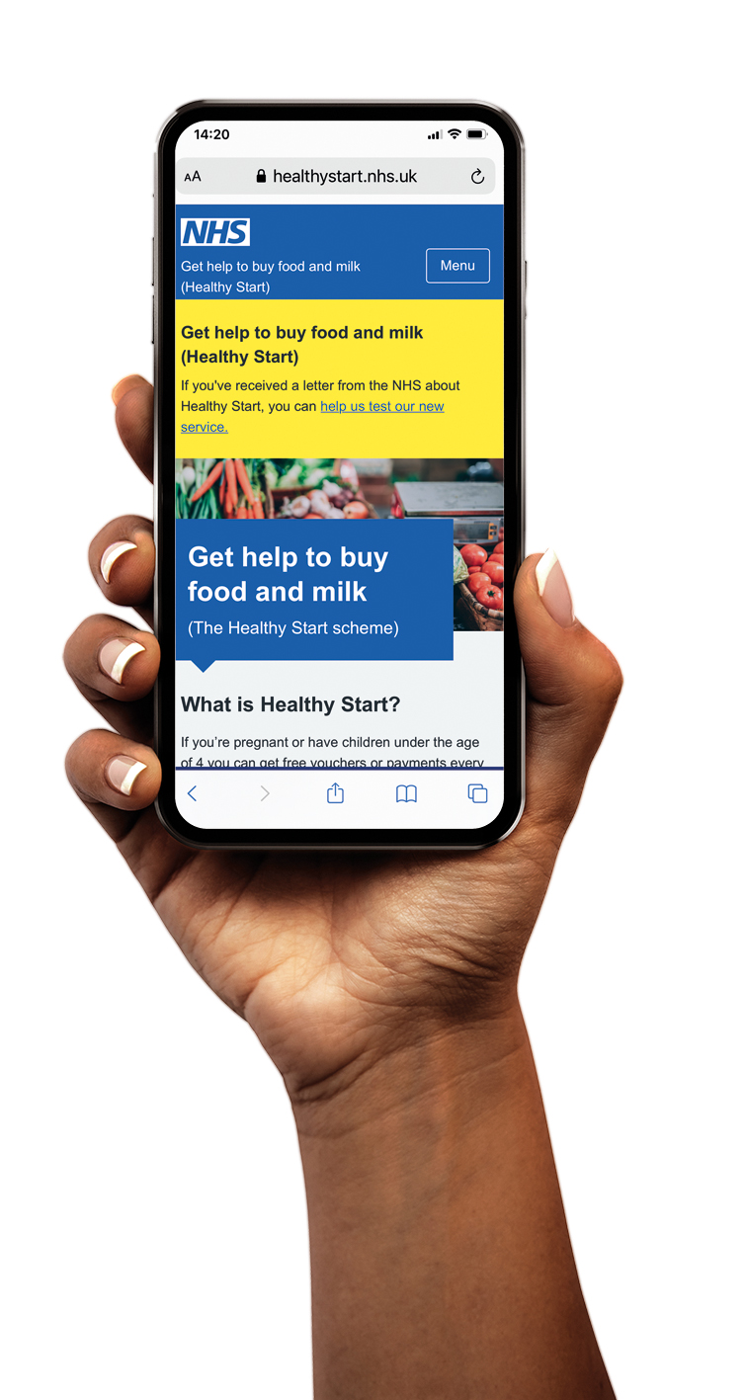
Useful websites for families
Healthy Start website
www.healthystart.nhs.uk
SSBC website
www.smallstepsbigchanges.org.uk /healthy-start

Slide 6
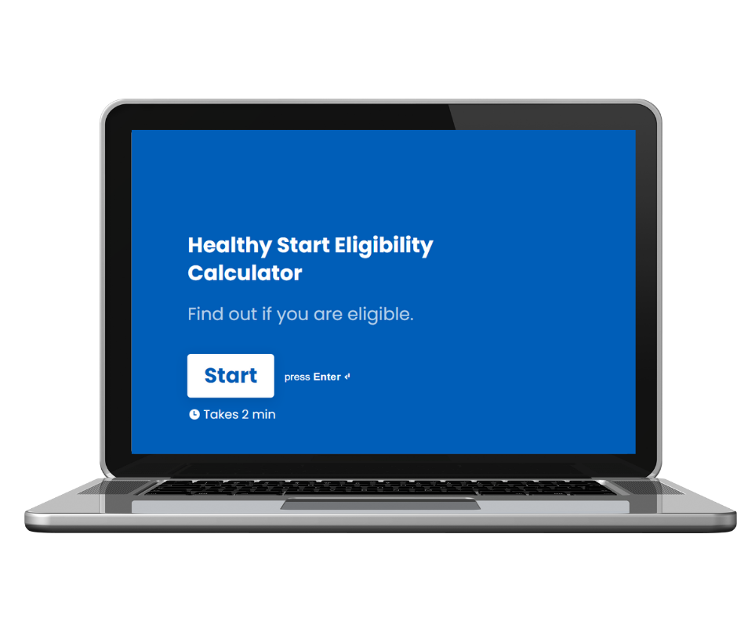
Useful websites for families
Healthy Start eligibility calculator
Powered by Sustain
5 questions
Takes 2 minutes to complete
www.form.typeform.com/to/WE0ncrBs

Slide 7
Troubleshooting
Contact the NHS Healthy Start team:
Card queries Phone: 0300 330 2090
(24 hours a day, 7 days a week)
General enquiries Email: healthy.start@nhsbsa.nhs.uk
Phone: 0300 330 7010 (8am-6pm Monday to Friday; except public holidays)
Translation support Phone: 0300 330 7010 (Select option 3)
(8am-6pm Monday to Friday; except public holidays)
www.healthystart.nhs.uk/contact-us

Slide 8
Troubleshooting
Join the conversation – sign up to the Healthy Start email forum.
Ask questions
Share resources
Get support from others working on the scheme.
Join: healthy_start-subscribe@lists.riseup.net
Once subscribed you can send a message to everyone in the group by emailing: healthy_start@lists.riseup.net
www.sustainweb.org/foodpoverty/healthy_start

Slide 9
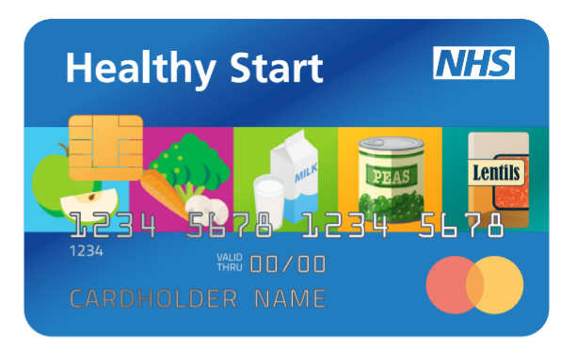
Workforce training
SSBC has developed a training package for local workforce.
Quiz
Training presentations
The training includes information on:
Eligibility criteria
How to apply
Using the card: where you can shop and what you can buy
Healthy Start vitamins
Contacting Healthy Start
www.smallstepsbigchanges.org.uk/resources/healthy-start

Slide 10
Steps to support promotion
We can all help increase local uptake of the Healthy Start scheme by:
Using Healthy Start promotional materials in relevant settings & on social media.
Embedding information about Healthy Start eligibility into routine support offered and inductions for new starters.
Appointing one or more Healthy Start Champions in your team/organisation.
Supporting ESOL families to use the Healthy Start phone translation service.
Working with local retailers to improve in-store promotion of Healthy Start.
Join the Healthy Start email forum to ask questions, share resources & expertise and get support.
Training staff/volunteers to support families to apply.
www.sustainweb.org/foodpoverty/healthy_start

